Slide 1
SCIENCE
CLASS VI
MOTION

Slide 2
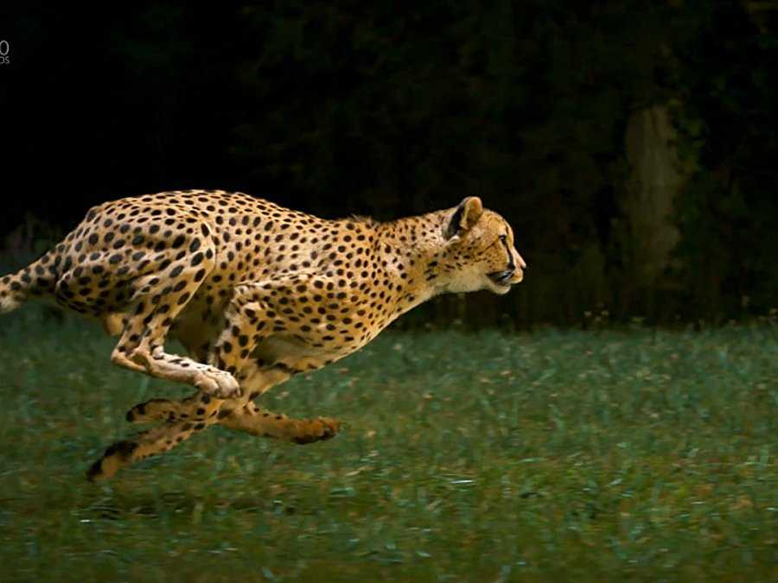
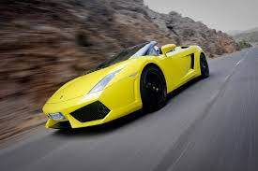

WHAT IS MOTION
Motion is the transfer or movement of an object from one place to another.

Slide 3
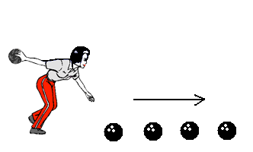
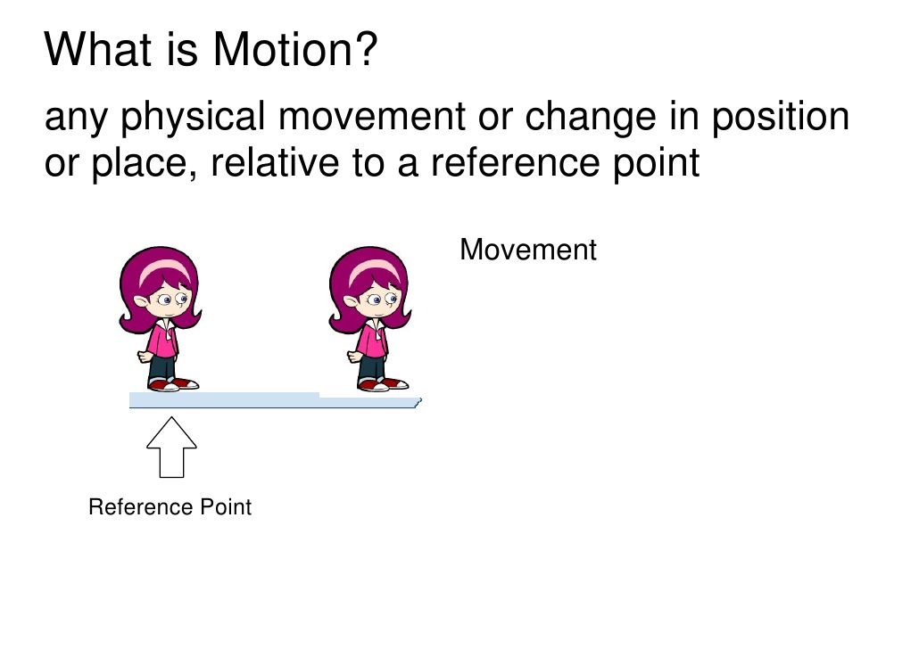

In physics, motion is a change in position of an object with respect to time eg. a butterfly flying, a ball moving along the ground etc.

Slide 4
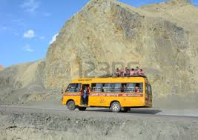

MOTION and REST
Motion:-A body is said be in a state of motion if it changes its position continuously with respect to its surroundings with the passage of time.
Eg A bus running on a road, a flying bird etc
Rest:- A body is said to be at rest if it does not change its position continuously with respect to its surroundings with the passage of time.
Eg A book lying on a table, a man standing on a road etc

Slide 5
Rest and Motion
are relative and
not absolute.
Absolute =Something that does not depends on anything else.
Relative = Something that is dependent on other things.

Slide 6
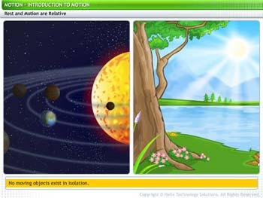
Rest and motion are relative terms.
A body may seem to be at rest with respect to one object, but may appear to be in motion with respect to another object.
No moving object exists in isolation.

Slide 7
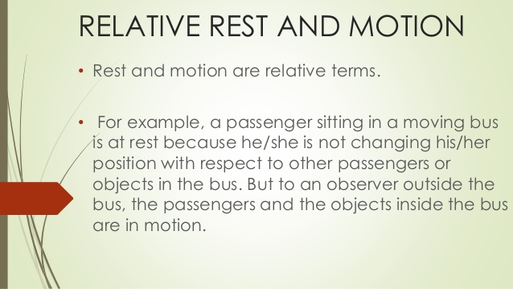

Slide 8
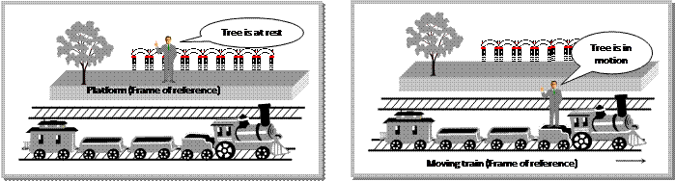
A Person on the Platform
A person on the platform is at rest with reference to any other person on the platform and is in motion with reference to a person viewing him from a moving train.

Slide 9
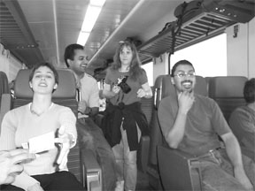
People in the train at rest for each other

Slide 10
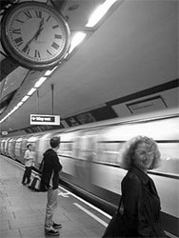
The same people in motion for people outside the train

Slide 11
Therefore, "A person seated in a moving train is at rest in relation to any other person (body) in the same train but is in motion in relation to any other person (body) outside the train.

Slide 12

REST AND MOTION
(Click to watch the video)

Slide 14
THANKYOU
-Vishakha

